Slide 1
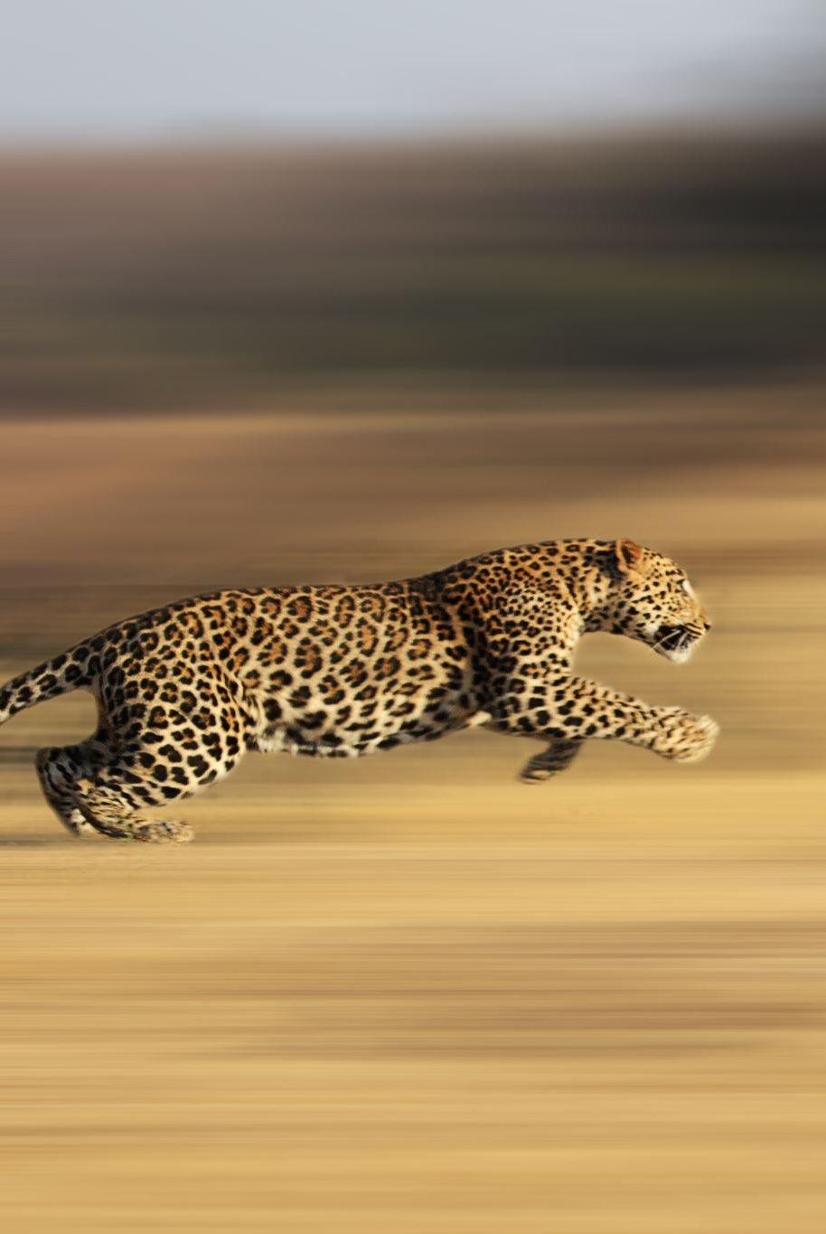
Cheetahs
(Acinonyx jubatus)
The fastest animal one Earth

Slide 2
Where they live
They usually live in the countries of North Africa, and Iran.
Their preferred habitats are shrublands, grasslands, savannahs

Slide 3
What is their role in the ecosystem
They role in the ecosystem is that of a predator.
What they eat is Small antelope, the young of larger animals.
(Small antelope include: Springbok, Steenbok, Duikers, Impala, and Gazelles)

Slide 4
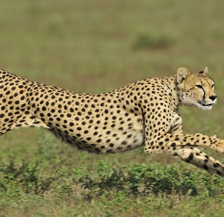
Features of a cheetah
Cheetahs are both long and slim. They also have muscular long legs, to take long strides and to store and release energy. It also have a flexible spine to help with strides and move the back legs move in front of the other one when running. They also have spots to help with camouflage.

Slide 5
Cause of endangerment
The main cause of endangerment for Cheetahs is destruction of their habits, and lack of prey, and being hunted.

Slide 6
How to help them
You can help Cheetahs by trying to stop poaching, and stop moving on there land.
You can also donate to funds like Dewildt Cheetah, and Wildlife Centre.

Slide 7
Sources
PBS
Wildlife
SeaWorld
Tripod
National Geo
Outtoafrica
Si.edu
Hope for Cheetahs

